Slide 1

CODESMITH
Hotelify
A Hotel management System

Slide 2
Back to Overview
Why Hotelify?
Organized access to hotel services
Easy of use for Guests and Employees
Centralized application for all hotel needs

Slide 3

Overview :
Interfaces :
Guest Interface
Employee Interface
Admin Interface
Frontend
Javafx and Scenebuilder.
Backend
Java.
Database
MySQL.

Slide 4

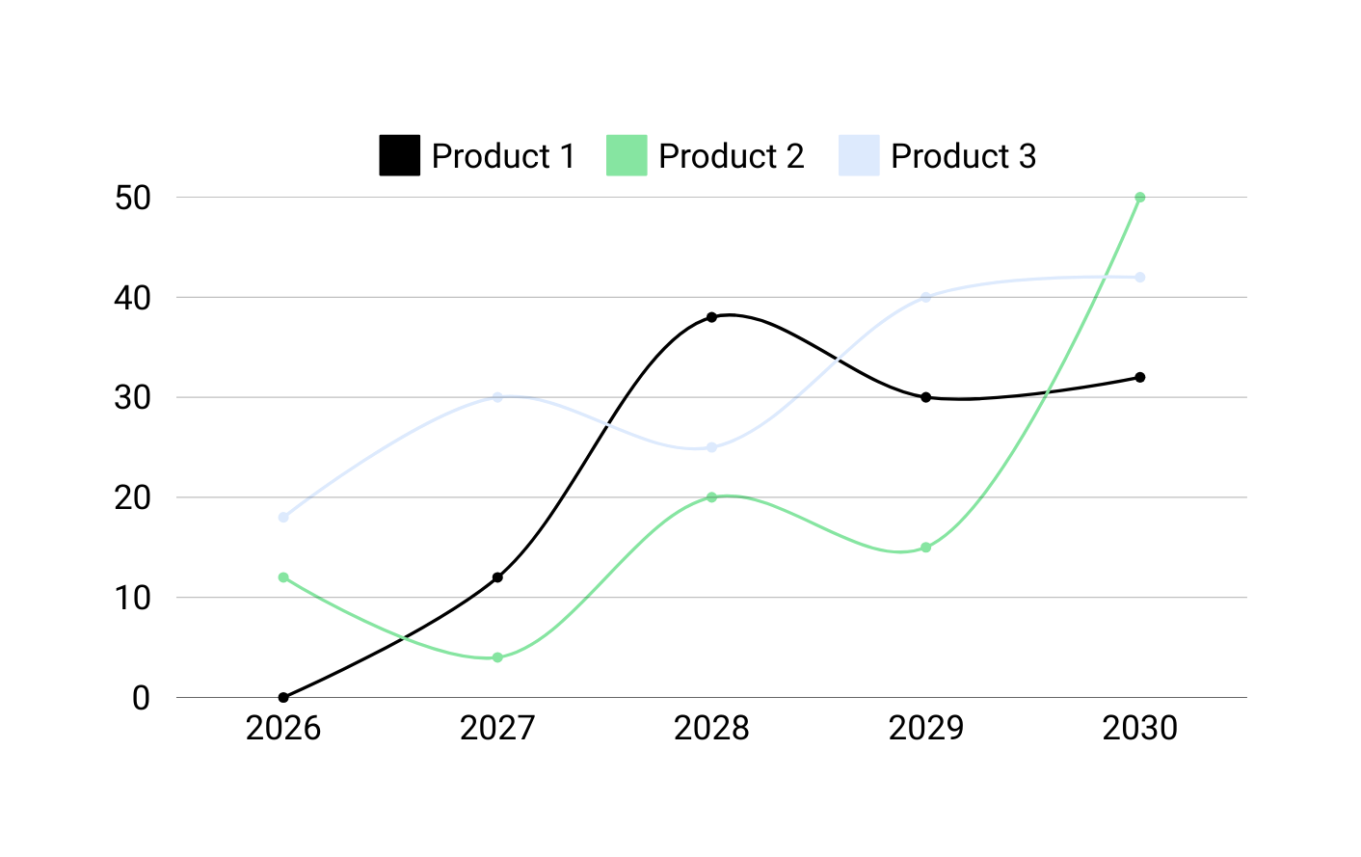
Guest Interface

Slide 5

Guest Interface

Slide 6

Employee Interface

Slide 7

Employee Interface

Slide 8

Admin Interface

Slide 9

Admin Interface

Slide 10
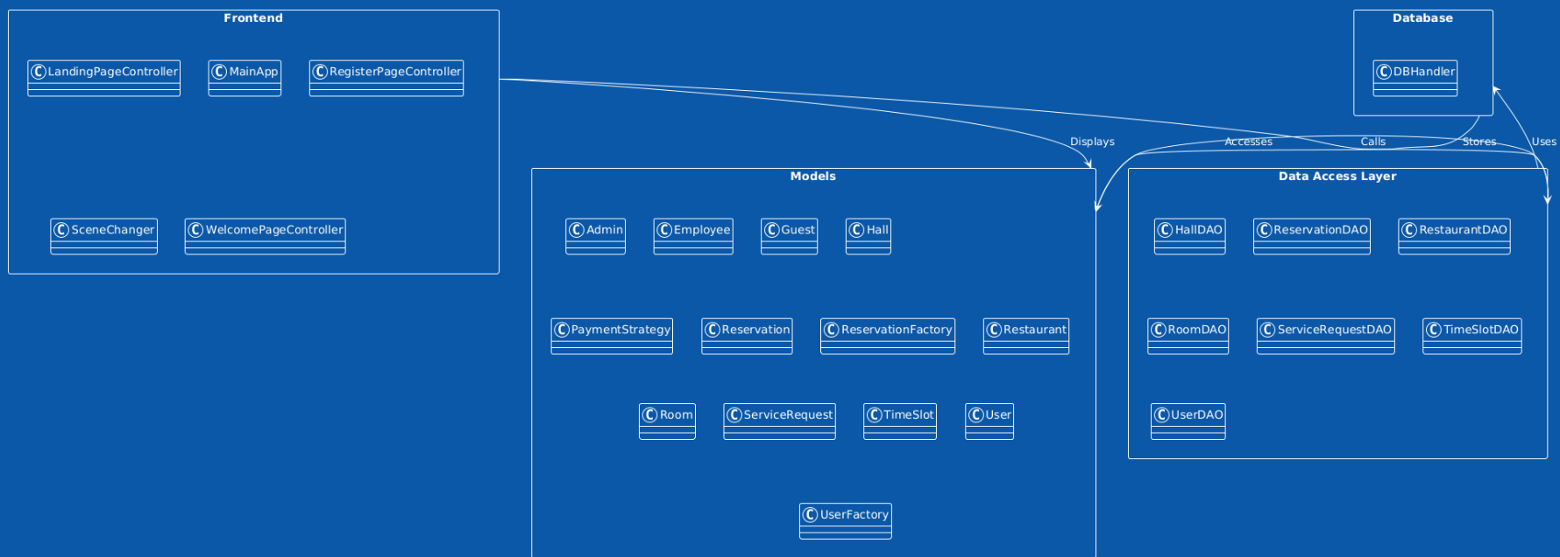
Package Diagram

Slide 11
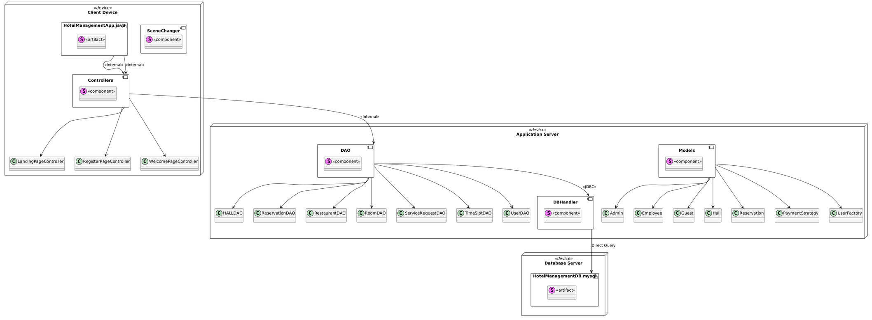
Deployment Diagram

Slide 12
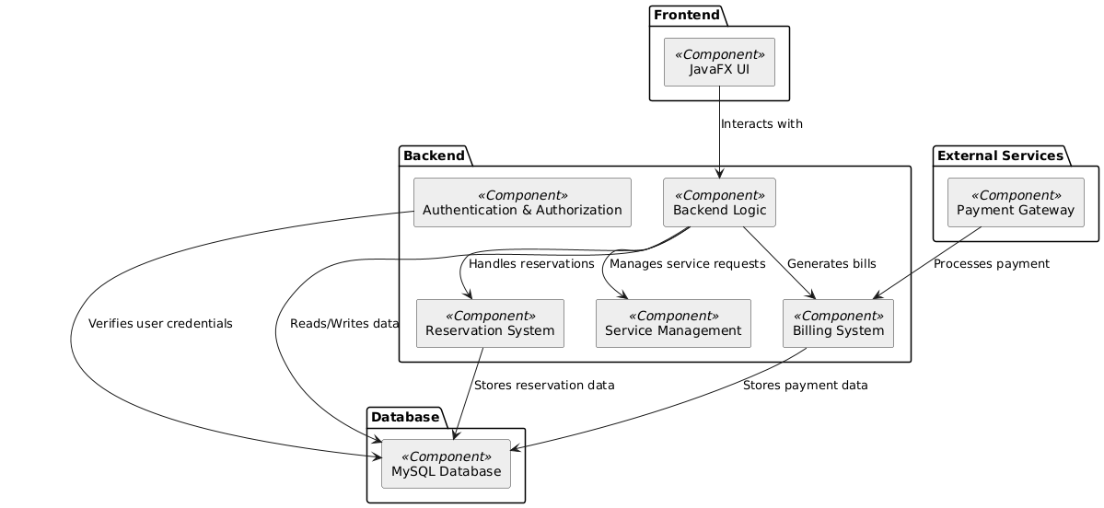
Component Diagram

Slide 13
Use Case

Slide 14



OUR TEAM
Ibraheem Farrukh
Sohaib Sattar
Aoun Jee
Developer
Developer/QA Analyst
Scrum Master

